Slide 1
Part I: Effective Cleaning Strategies for the Environment of Care
By Sue Chen RN, MPH, CIC, FAPIC
Infection Preventionist/Consultant

Slide 2
Objectives
Define cleaning
Strategize how to best clean
Differentiate between detergents and disinfectants
EPA-registered disinfectants
Wet contact time
Discuss the optimal way to clean, including porous hospital surfaces
Discuss barriers to effective cleaning and disinfection

Slide 3
Role of the Healthcare Environment
Research shows numerous outbreaks where the environment was implicated as a reservoir for HAI pathogens (Currie, Weber, Calfee, AHRQ Technical Brief #22)
In one outbreak, 37% objects in room were contaminated with outbreak organism
Implicated objects: high touch areas, objects that go between patients (e.g. water cart, BP cuffs), privacy curtains, X-ray machines (Rutala, HICPAC GL for Isol Prec)
Patients shed upon admission; within a few hours, their pathogens are dominant. Bacteria settle on horizontal surfaces
Objects nearer the patient are more contaminated
Some bacteria (e.g., MRSA, VRE, C. diff, Acinetobacter spp) can persist for weeks to months)
(Donskey, Otter, Galvin, Environmental Health Perspectives)
Notes:
“Rethinking Sterile” (Arnold) discusses the human microbiome in relation to their hospital room environment

Slide 4
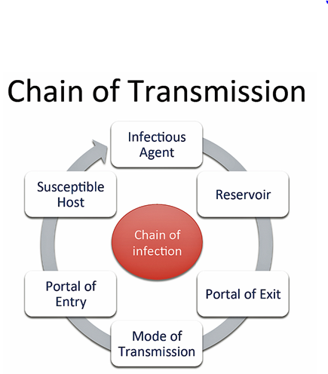
Dirty Environment → Disease Transmission
Cycle of Disease Transmission
How Transmission Occurs
Surface must become contaminated
Organisms must survive on surface
Organism is picked up by a person in sufficient quantity
Person must omit or poorly perform hand hygiene
Person must transmit organism to another patient or object in sufficient quantity to cause disease (Bennett & Brachman, HICPAC)
http://diseasedetectives.wikia.com/wiki/Chain_of_Transmission
Notes:
Direct: Hand to hand, abraded area to surface where pathogen is parked (example – rowers rubbing shoulders against boat when carrying it develop skin infection at abraded area)
Indirect: hand to environment to patient or vice versa

Slide 5
What is Cleaning? What are Cleaning Strategies?
CDC Definition of Cleaning:
“Removal, usually with detergent…, of adherent visible soil, blood, protein substances, microorganisms and other debris from surfaces, crevices, … by a manual or mechanical process that prepares items for… further decontamination” (HICPAC)
Traditional cleaning methods do not automatically provide disinfection (Dancer)
Strategies to reduce environmental bioburden:
Improve cleaning in rooms of patients known to carry HAI pathogens after discharge
Daily disinfection of touchable objects and portable equipment
Cleaning and disinfection should be done in all rooms to reduce potential transmission from environment if colonized patients are not recognized (Donskey)
Notes:
There is no standard for cleanliness!

Slide 6
The Importance of Manual Cleaning
How long bacteria can live on a surface depends on
Temperature, humidity, surface porosity, number deposited, type of microbe, disinfectant residual
Some bacteria (C. diff, Acinetobacter) naturally more resistant to disinfectants
Bacteria can survive when ‘sprayed and wiped’ rather than actively scrubbed (Dancer)
Failure of cleaning and disinfection show that the next occupant of that room is twice as likely to become colonized or infected (Rutala)
Disinfectants work best on pre-cleaned surfaces (everybody)
Notes:
Acinetobacter is twice as likely to be transmitted to the next occupant than other organisms (add quote w/ %)

Slide 7
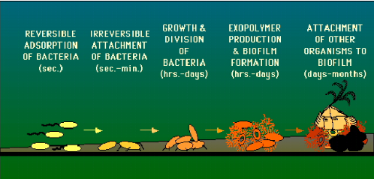
Biofilm – Why it is so Important to Prevent
Biofilm is a layer of living and dead cells firmly attached to a surface under a protective coating (Hu, Lindsay)
Coating protects bacteria from antibiotics and disinfectants (50 times more disinfectant required for kill than if biofilm not present)
Organisms live longer and can transfer drug resistance to other organisms; can be dried onto a surface
The best way to minimize biofilm is to prevent initial attachment; this requires manual cleaning with friction followed by disinfection
http://www.personal.psu.edu/faculty/j/e/jel5/biofilms/primer.html

Slide 8
What Should I Use to Clean? A Detergent?
A detergent is a sanitizer that reduces the number of germs on a surface to a level that poses an insignificant risk to health
Contain a surfactant that lifts dirt so it can be rinsed away
More environmentally friendly (less toxic) and less odor
No antimicrobial claims on the label
Will reduce Staphylococci on surfaces but not eliminate them
No difference in infection rates noted when a detergent was used on non-critical surfaces such as floors or walls
Should not be used in an outbreak setting
(MMWR 2003, APIC Text 2013, CDC, Mulvey)

Slide 9
Or a Disinfectant?
Disinfectants inactivate microorganisms by inhibiting growth, preventing reproduction, or killing them.
Appropriate for use on horizontal surfaces in patient rooms, medical equipment, in isolation rooms, and during an outbreak
Organic material such as dirt interfere with their ability to disinfect
The dirtier an object, the less well the disinfectant works
Biofilm can protect microorganisms from disinfectants
EPA-registered disinfectants will have a “kill” claim on the label (Maris, Sattar, HICPAC, AJIC Text 2013, Alfa)
For more information on specific disinfectants, please see the CDC or HAI Program website
Notes:
Organic matter in the form of serum, blood, pus, fecal or lubricant material can interfere with the antimicrobial activity of disinfectants in at least two ways.
Efficacy is inversely proportional to the level of bioburden found on the item to be disinfected. Most commonly, interference occurs by a chemical reaction between the germicide and organic material, resulting in a complex that is less germicidal or non-germicidal, thereby leaving less active agent to attack the microorganisms. Chlorine and iodine disinfectants in particular are prone to such interaction.
Organic material such as biofilm can protect micrororganisms from attack by acting as a physical barrier.

Slide 10
How is the Level of Disinfectant Chosen?
Factors influencing choice of disinfection:
Nature of item to be disinfected
Innate resistance of microorganisms to deactivation by germicides (see next slide)
Level of bioburden on the item
Type and concentration of germicide to be used
Duration and temperature of germicide contact
Applicable laws, e.g., Cal/OSHA BBP Standard requires use of a hospital-grade disinfectant with a tuberculocidal claim to kill HBV
There is information on classes of disinfectants on the CDC website and a table comparing the different classes on the HAI Program website and the APIC text.
https://uwaterloo.ca/safety-office/sites/ca.safety-office/files/uploads/files/guide-selection-use-of-disinfectants.pdf

Slide 11
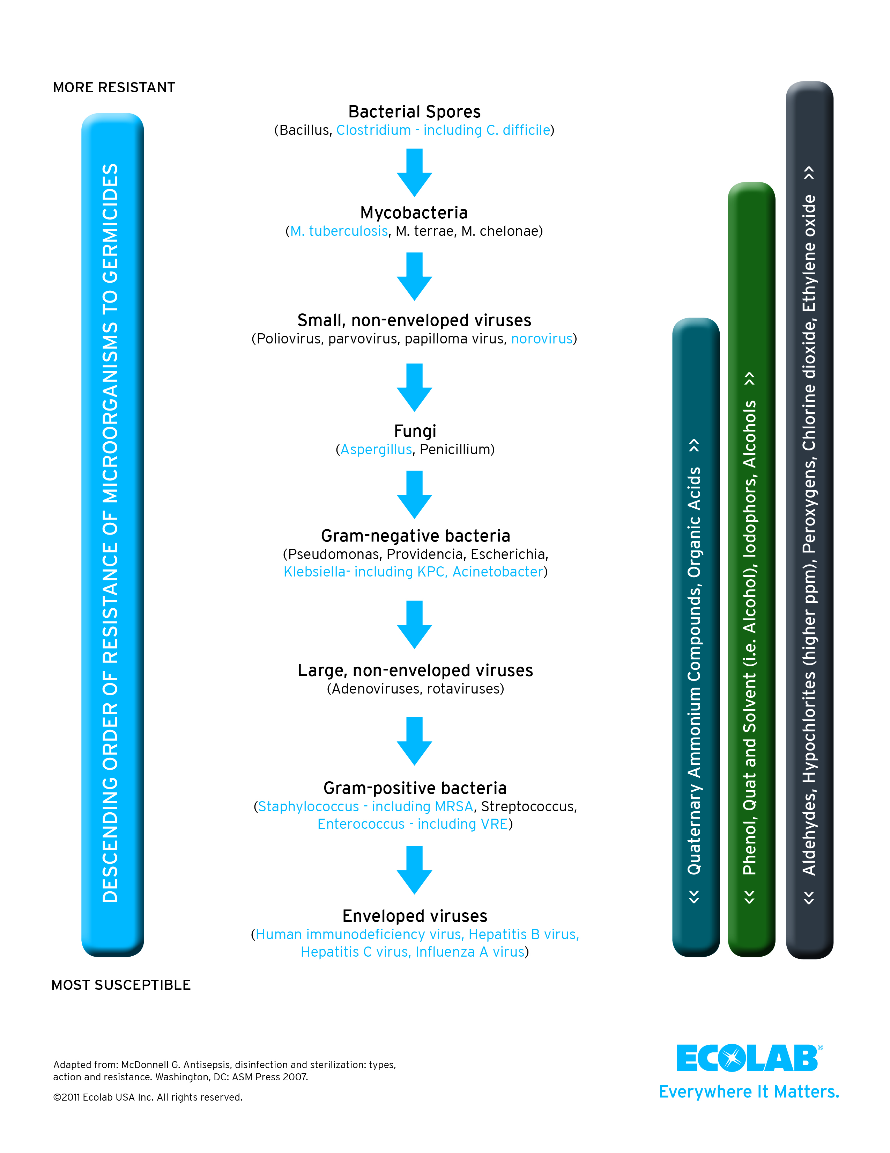
Demonstrating the susceptibility of organisms to specific disinfectant types
Graphic used with permission from Ecolab- 2015

Slide 12
What does “EPA*-registered” mean? (*Environmental Protection Agency)
EPA-registration means the manufacturer has provided satisfactory evidence that product performs as stated
Disinfectants are considered pesticides (poisons)
Are designed for use on environmental surfaces
After evidence is submitted, the product is allowed to have claims for “kill” on the product label; organisms tested are listed
Disinfectants used in hospitals must have a label claim
Levels of disinfectants
Low level only tested to be effective against Pseudomonas and Staphylococcus
Intermediate grade is effective against more organisms, may or may not have a tuberculocidal claim
High level disinfectants can provide sterilization; are FDA-regulated
If disinfectant doesn’t perform as stated, it can be pulled
from the market
(HICPAC, Rutala, EPA, MMWR 2003, OSHA, Alvarez)
Notes:
Disinfectants are classified by level of kill claimed on the label. A low level (hospital-grade) disinfectant is EPA-defined and registered to be effective against pseudomonas aeruginosa and staphylococcus aureus. They are appropriately used to clean common areas such as hallways and floors. An intermediate level disinfectant is defined as having been tested against TB, bacteria, fungi, and viruses. Some may have a sporicidal claim. Quats and phenolics are common intermediate level disinfectants. High level disinfectants fall under the Food and Drug Administration (FDA) as they make claims as sterilants. Gluteraldehyde, OPA, hydrogen peroxide, and peracetic acid are examples of high level disinfectants.
The Federal Insecticide, Fungicide, and Rodenticide Act (FIFRA – 1996) provides for federal regulation of pesticide distribution, sale, and use. Disinfectants are classified as pesticides. Thus the EPA exercises authority to require testing for hospital-level disinfectants and that testing be conducted in real life situations, including with hard water and/or on non-porous surfaces. Manufacturers must perform extensive laboratory testing to demonstrate safety and efficacy of the product, a process that takes 18-24 months. Upon approval, the EPA then issues a registration number and allows the manufacturer to print claim information on the product label (‘label claim’). Each strain on the label must be supported by efficacy data. Hospitals must have a disinfectant available capable of disinfecting blood spills (HBV and HIV claim). Importantly, the label must clarify manufacturer’s instructions for use, including how long the disinfectant must remain wet on the surface to achieve the desired degree of microbial killing. An example is that a 1:10 solution of bleach requires 10 minutes wet contact time to ‘kill’ c diff spores. A list of disinfectants by category of organism they are effective against can be found at http://www.epa.gov/oppad001/chemregindex.htm

Slide 13
What is “wet contact time”?
Wet contact time is the time required for a disinfectant to kill microorganisms on a pre-cleaned surface
It is ideally equal or longer than the disinfectant kill time listed on the label
Wet contact time is listed on the product label. CMS enforces longest time listed as one may not accurately predict which organisms are on the surface to be cleaned
If uncertain because the pathogen is new, the disinfectant should be selected based on hierarchy of susceptibility for the microbe
(MMWR Appendix A 2003, Pyrek, Rutala, EPA website)

Slide 14
Categories of Surfaces for Frequency of Cleaning
Frequently touched surfaces:
Clean minimally daily
Clean more frequently during an outbreak
Clean when visibly soiled
Use intermediate level disinfectant
Common areas/minimal hand contact: (floors, ceilings, walls)
Clean @ regular intervals and when soiled
Areas require regular cleaning even if resources are stretched
Can use a low level disinfectant
(Bennett & Brachman, Huang)
Notes:
Some facilities choose not to use different levels of disinfectants and/or use disinfectants that are also detergents to simplify the number of products used and/or decrease confusion . This is up to your facility policy.

Slide 15
Some facilities choose not to use different levels of disinfectants and/or use disinfectants that also contain detergents to simplify the number of products used and/or decrease confusion. The types of products used is up to your facility policy (APIC Text 2013)
Efforts should be made to use the least noxious product for cleaning in a patient care area. (Obee)
Suggested tool for clarifying use of detergents/ disinfectants in your facility
Name of Facility Product | Surfaces to Use Product On | Required Wet Contact Time
10% bleach | C. Diff isolation rooms | 10 minutes
and so on

Slide 16
What is a High Touch Object (HTO)?
As defined by the CDC, patient room HTO include:
Bed rails/controls, call bell, TV remote, tables in room, chairs, surfaces in bathrooms, IV poles and pumps, monitor cables/controls, ventilator controls, …
In an operating room, there are
extra tables/controls, light handles, procedure carts, the anesthesia cart, mayo cart, basins, operating room tables and mattresses, …
Sometimes overlooked: computer keyboards/mice, touch screen monitors, medication cart locks, hampers, ATP testing machine, PPE holder, …
HTO are sometimes called ‘touchable’ objects. One study found no correlation between frequency of touch and the level of contamination (Rutala, Huslage)
Per Rutala, there’s not an epidemiological definition of what constitutes a “high touch” object

Slide 17
Best Practices for Cleaning
Wash hands prior to starting (Lillis)
To protect self
Staff may be inadvertently going for example, from trash to touching something in patient room, thus spreading germs
Staff may not understand hand hygiene protocol or importance
Wear appropriate PPE
PPE based on infection prevention precautions the patient was on, chemicals to be used
Learn and practice removing PPE safely: a study showed contamination of HCW when removing gown 38% of time, removing gloves 53% of time (Tomas)
Clean highly contaminated areas last (like bathroom)
Don’t raise dust; change the rag when it’s dirty

Slide 18
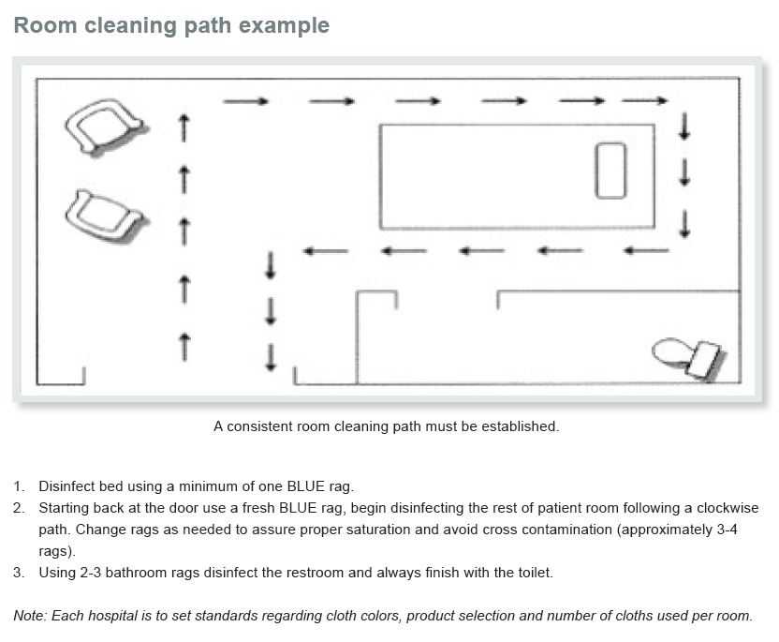
Clean Room Systematically
Manufacturer recommendations for number of cloths to use
Minnesota Hospital Association, “Cleaning Protocol for Environmental Surfaces”, 2014-2016

Slide 19
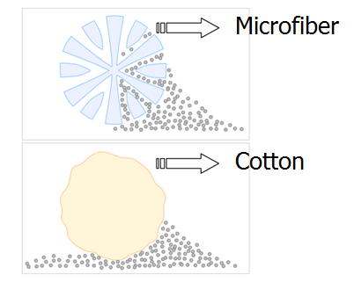
Cotton vs. Microfiber vs. Wipes
How many cloths should be used to clean a room?
The manufacturer may have suggestions such as folding strategies to maximize clean surfaces of the cloth
Never go from dirty to clean with the same cloth
Cotton: traditionally used, is inexpensive, readily available; can be laundered in hot water, bleached
Microfiber: made of millions of tiny filaments (1/16 diameter of a human hair) that attract dust; picks up more than cotton because has more surface area; can clean with less detergent. An ‘e’ microfiber is recently available. Filaments are 1/200 diameter. The rag can be washed and dried in hot water. It has claims to remove 99.9& bacteria.
Ask manufacturer about durability
Notes:
One hospital noted a high level of contaminants from re-usable cleaning cloths; another linked contaminated cleaning cloths to an outbreak of Bacillus cereus. Hospital laundering practices need to be sufficient to remove these contaminants so that subsequent use will not increase room contamination.
Sifuentes LY, Microbial contamination of hospital cleaning towels, AJIC, 2013
Dohmae S, Bacillus cereus nosocomial infection from reused towels in Japan, Journal of Hospital Infection, 2009

Slide 20
Commentary Continued
Microfiber:
Compared to cotton, microfiber picked up more c. diff spores and release fewer to a subsequently wiped surface
Wipes:
Easy to use
May increase compliance with cleaning and disinfection (e.g., orphan objects)
No buckets needed
Remove both bacteria and spores; difference may not be statistically different from when gauze and water used
Show variability in performance; bleach wipes most effective
Have a propensity to transfer significant amounts of bacteria/spores when used on three consecutive surfaces
(Wiemken, Lestage, Gonzales, Gold, Mpharm)

Slide 21
How to Apply Product to a Surface
Disinfectant can be applied directly to a surface or per a cleaning rag (follow manufacturer’s instructions)
If soaked in the bucket, cotton will absorb quaternary ammonium products; this decreases dilution
Rag must be sufficiently wet to achieve wet contact time. If not, disinfectant should be re-applied
Squirt, don’t aerosolize, the disinfectant
Aerosolization means a propellant is used to dispense the liquid in a very fine mist (e.g., hair spray)
Squirt bottles dispense liquid in very large droplets
Application of detergent or disinfectant is independent of and cannot replace manual friction to remove the dirt

Slide 22
Different Types of Mops
Traditionally used to clean floors
Decontaminate regularly to prevent spread of organisms
Cotton mop:
When used without and with a disinfectant, microbial pick-up increased from 68 to 95%
Weighs ~10 pounds
Microfiber mop
No difference in mop pick up efficacy whether or not disinfectant was used
Compared to cotton, pick up was 68% for cotton, 95% for microfiber
Is not effective on greasy kitchen floors or marble

Slide 23
Mopping Up
Open bucket system:
Mop dipped repetitively in a bucket (such as in operating room
Mop becomes increasingly contaminated
Water must be changed frequently – per number of rooms or specified time
Closed bucket system:
Container of wipes immersed in disinfectant
Study: at end of 8 hour shift, quaternary ammonium released from wipe was 21.5% of original concentration; if wipe used was designed for the disinfectant, 83.6% quat remained (HICPAC, APIC Text 2013, Mohamed)
Notes:
Moral of the story: Closed bucket systems are fine so long as one does not use the solution for too long. Efficacy of detergent is more sustained if system has been designed and product tested to be used in that manner. Look at label claim.

Slide 24
‘Orphan’ Equipment
Mobile equipment that moves from room to room; surfaces can carry HAI pathogens (Carling, Pyrek)
Examples: stethoscope, electric thermometer, pulse ox, IV poles, patient scale, wheel chair, X-ray machine, cart for passing drinking water,… with caveat for BP cuffs
Should be cleaned and disinfectant after each patient use; follow manufacturer’s recommendations
Facility policy needs to specify whether the item is cleaned by housekeepers or nursing staff
When taken from a room for storage, is there a system in place whereby the next user knows whether and when the equipment was cleaned?
Notes:
Note: when a manufacturer cites a specific disinfectant, they have tested using that disinfectant. This does not mean that is the only disinfectant or wipe that can be used, just that the device was not tested against other brands of disinfectants. Check with the manufacturer prior to using a product that has not been specifically recommended.
BP cuffs – Some literature puts BP cuffs in the category of mobile care equipment, so they would need to be cleaned between uses by different patients. The CDC Guideline for Sterilization and Disinfection state that so long as the cuff does not come in contact with non-intact skin, virtually no risk has been documented for transmission of pathogens through non-critical items.

Slide 25
Privacy Curtains
Considered a high touch surface by the CDC; can become rapidly contaminated, especially in isolation rooms;
Organisms can survive on curtains; have been linked to outbreaks of Group A strep, CRE and more
Recommendations for frequency of curtain change:
Upon patient discharge, transfer, at designated time frame or if visibly soiled
Curtains can be spot-cleaned with a hydrogen-peroxide product (Rutala)
Antimicrobial, sporicidal and disposable curtains are commercially available (APIC Text 2013, MMWR 2003, Kotsanas)
May lessen labor costs

Slide 26
Carpeting
While more bacteria can be found on carpeting than floors, there is no evidence that carpeting is linked to increased risk of HAIs
Not recommended for clinical areas
Need to be regularly vacuumed
For liquid spill, extract excess to greatest extent possible
Steam clean if carpet can tolerate it; let dry for 72 hrs to prevent growth of mold
If disinfection needed, test disinfectant on a small area prior to use for colorfastness
If methods unsuccessful, carpet may need to be discarded
(MMWR 2003, APIC Text 2014, Cadnum, Rutala)

Slide 27
Toilet Bowl Brushes
Toilet bowls represent an underappreciated source of contamination: a brush can carry pathogens from room to room
78% surfaces in a bathroom and 81% aerosols from flushing contained enteric viruses
C. diff has been recovered from 10” above the toilet seat; contamination continued for 90 min after flush (yuck factor)
No guidance is provided in the literature on how to disinfect brushes after use
Guidance from Canada suggests leaving the brush in the room, use of disposable brushes, or devising a method to disinfect brushes between patient rooms.
(Veroni, Best, Alfa, Canadian Prov Inf Disease Adv Comm, Best)

Slide 28
Miscellaneous
Vacuum Cleaners
Should have a HEPA* filter, be in good working order. If plumes of dust are coming from bag, shut down immediately and send it for repair
Mattresses – Don’t let the bed bugs bite!
FDA issued warning in 2013 after HAI pathogens were cultured from mattresses after terminal cleaning
Need same attention for cleaning and disinfection as other objects in room
Cover should be intact, fluid-impervious; inspect regularly and replace if torn, cracked or there are holes in the cover
Not intended as a pin cushion for syringes
Launderable mattress covers were shown to decrease CDI by 50% in two long term acute care facilities (Hooker)
Notes:
Of note, the EPA does not/has issued no kill claim for soft surfaces. Marketers may imply this but cannot put it into writing.

Slide 29
More Miscellaneous
Mold
Mold is associated with high mortality in immunocompromised persons
Key to cleaning up mold to control the source of moisture
The EPA has issued guidance
Bleach is not effective against mold on porous surfaces
Ventilation Ducts
There is no written guidance on required frequency for cleaning ventilation ducts
Per expert opinion, preventive maintenance should be current (see notes page), exhaust and supply systems every 3 years, and supply systems every 5 years. Clean ventilation ducts as needed
Bartley J, Eikam G (UC Irvine, personal communication)
Notes:
While there is nothing written by professional organizations on a required frequency for cleaning ventilation ducts, the plan for preventive maintenance should include regular cleaning of air intakes, supply/exhaust/return vents, ducts, and cooling towers. Exhaust and return systems should be cleaned about every three years and supply systems approximately every five years. Inspect and clean vents on an as needed basis.
Bartley, J, Heating, Ventilation and Air Conditioning, APIC Text, Ch 114
Eikam, G, Director of Facilities Management, UC Irvine. Personal communication Jan 6, 2016

Slide 30
Barriers to Thorough Cleaning
Per the AHE*, terminal cleaning should take 40-45 min, dependent upon
Room size
Amount of equipment and furniture
Amount of clutter
Each facility might wish to set their own benchmark for time to be allotted for terminally cleaning a room
On pressure from clinical staff to speed the process: “Would a physician tolerate being expected to remove a gall bladder in 10 minutes?” (Pyrek)
*AHE-Association for Healthcare Environment Services
Notes:
The notorious CDI outbreak in Quebec in 2006 involving C. diff NAP1 was preceded by the outsourcing of EVS in the involved hospitals. The coroner investigating deaths of Québec hospital patients from C. diff-associated infections in 2006 determined that “the way to avoid an outbreak is to prioritize cleanliness and hygienic measures in every facility.” The coroner found that the hospital was only able to control the outbreak after providing additional infection prevention training and adding 10 new cleaners to the staff.
Certification for EVS supervisors and a different level for front line staff is available from AHE

Slide 31
Patient intolerance to disinfectant odor
If the patient is mobile, can staff return when the patient is out?
As the purpose is to remove bacteria and dirt, although cleaning with only water and microfiber is not generally recommended, it is better than nothing* (Wren)
Consider providing education to the patient, family and visitors of the importance of allowing staff to clean the environment surrounding the patient
* The literature shows that contamination of healthcare worker attire, gowns and gloves is directly proportional to the bioburden in the environment. More contamination leads to increased risk of colonization or infection for the patient. CDPH is not recommending routine cleaning without detergents or disinfectants.
Notes:
There are newer technologies becoming available that leave little to no odor behind. Question is whether the patient can be present while the cleaning is being done.

Slide 32
Potential Worker Health Issues
Consistent associations have been found between disinfectant use and asthma in HCW
Disinfectants should never be aerosolized (defined as ‘dispersed as a fine mist using a propellant’)
Practices to enhance worker safety:
Know which chemicals to mix or not mix, and proper dilutions (twice as strong does not mean twice as good, just more toxic)
Use proper PPE
Label containers appropriately
Ensure sufficient ventilation
When possible, select products w/ lower toxicity
Use a saturated cloth rather than spraying where feasible
OSHA.NIOSH, Quinn MM, MMWR notes 2016
Notes:
MMWR released Notes from the Field: Respiratory Symptoms and Skin Irritation Among Hospital Workers Using a New Disinfection Product – Pennsylvania, 2015 wherein workers developed watery eyes, nasal problems, asthma-like symptoms and/or shortness of breath after exposure to a cleaner/disinfectant/deodorizer product at levels below their respective respective occupational levels. The chemicals measured were hydrogen peroxide, acetic acid, and peroxyacetic acid.
Hawley B, MMWR Morb Mortal Wkly Rep 2016;65:400–1, http://www.cdc.gov/mmwr/volumes/656/wr/mm6515a3.hem?s_cid=mm6515a3_e accessed 4/21/2016

Slide 33
Green Products in Healthcare
‘Green’ when applied to healthcare products is not well defined; no guideline or strict definition. Green means:
May protect the environment
Has natural instead of artificial ingredients
Should have a positive impact on humans and the environment
Should help conserve resources for future generations
There was previously no such thing as a ‘green’ disinfectant as disinfectants kill; green products do not
As of April 2016, there is one EPA-registered disinfectant. It has kill claims for many common pathogenic organisms and works well against mold. Limitations are that it does not work well against non-enveloped viruses and has no spore kill claim. There is now a second – oxidizing water.
(EPA website, personal communication from J Heyd 4/26/16)

Slide 34
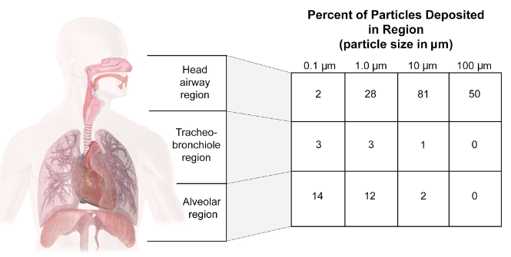
Why to Not Aerosolize Disinfectants
Inhaled particles are deposited in the lungs after inhalation.
Large particles will be caught in the back of the throat and swallowed. If the disinfectant is ‘aerosolized’, the smaller particles can be inhaled deeper into the lungs (into the alveoli) where they come in direct contact with blood during the gas exchange.
This level of exposure is what contributes to potentially severe hypersensitivity reactions such as asthma.
The EPA does not require testing for a health effect such as asthma.
“Squirting is not aerosolizing”

Slide 35
Cleaning up after Norovirus
Is most frequent cause of community-acquired acute gastroenteritis; spread person-to-person or per contaminated food; can be aerosolized in large droplets; is extremely contagious; disperses readily in air and dust; immunity against it is short-lived
Perform routine cleaning of HTO w/ an EPA-registered disinfectant
In one study, 47% (48/101) items in patient care areas were contaminated with the outbreak strain of norovirus. Increase cleaning frequency during outbreaks to minimize environmental contamination
Clean most highly contaminated areas last; change cloth frequently
Consider changing privacy curtains upon patient discharge or transfer
Staff watching the video on Vomiting Larry will have a better understand the extent of contamination and how thorough cleaning must be
https://www.youtube.com/watch?v=sLDSNvQjXe8
(Makison-Booth, MacCannell, Nenonen, CDC Control Recommendations)

Slide 36

Questions?
For more information, please contact
Sue Chen @ 980sue@comcast.net
Thank you
This information and content does not reflect the opinions of the California Department of Public Health (CDPH) Healthcare-Associated Infections (HAI) Program
As knowledge of best practices to clean the environment of care is changing so rapidly, the information presented here is only as current as the last date the slide set was worked on: October 21, 2016

